Slide 1
Biological Modeling of Neural Networks
Week 5: Networks of Neurons-Introduction
5.1 Introduction
- networks of neuron
- systems for computing
- associative memory
5.2 Classification by similarity
5.3 Detour: Magnetic Materials
5.4 Hopfield Model
5.5 Learning of Associations
5.6 Storage Capacity
Week 5
NETWORKS of NEURONS and
ASSOCIATIVE MEMORY
Wulfram Gerstner
EPFL, Lausanne, Switzerland
Notes:
The first part now took less than 35 minutes and leads up to the Swiss-cross exercise (1 pattern only!)
Second part: I started at 10:15 and took questions for exercise 1, and introduced the notation w_ij = p_i p_j that lead then naturally to the question of what can we do with several patters. I plugged in the weights in the dynamics and introduced the overlap; then I showed the demo, and explained why you should use random patterns. Then exercise 2 and 3
c) Third part: I started at 11:15 and showed how to do the calculation for exercise 3, explained orthogonality and why random patterns are nearly orthogonal. This then led over to the storage capacity for random patterns. I finished at 12:00

Slide 2
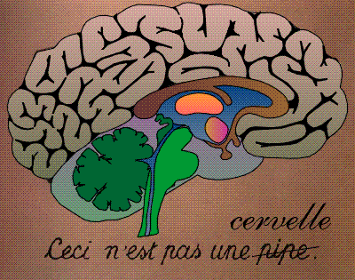
Systems for computing and information processing
Brain
Computer
memory
CPU
input
Distributed architecture
Von Neumann architecture
10
1 CPU
(10 proc. Elements/neurons)
10
(10 transistors)
No separation of
processing and memory

Slide 3
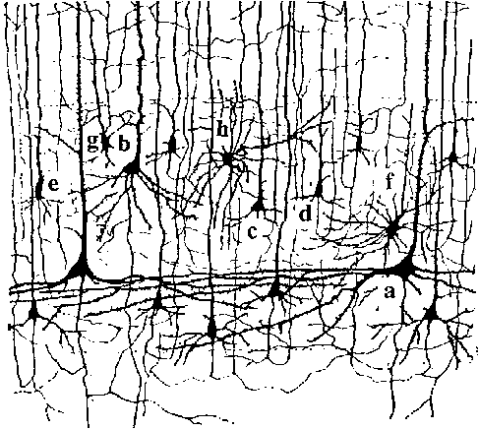
Systems for computing and information processing
1mm
10 000 neurons
3 km wire

Slide 4
Systems for computing and information processing
1mm
Brain
10 000 neurons
3 km wire
Distributed architecture
10
10 neurons
4
10 connections/neurons
No separation of
processing and memory

Slide 5
Associations, Associative Memory
Read this text NOW!
I find it rea*l* amazin* t*at y*u ar* abl* to re*d t*is tex* despit* th* fac* *hat more t*an t*ent* perc*n* of t** char*cte*s a*e mis*ing.
*his mean* t*at you* brai* i* abl* ** fill in missin* info*matio*.

Slide 6
pattern completion/word recognition
atom
brave
brain
brass
brai*
brain
Noisy word
List of words
Output the closest one
Your brain fills in missing information:
‘associative memory’

Slide 7
Biological Modeling of Neural Networks
Week 5: Networks of Neurons-Introduction
5.1 Introduction
- networks of neuron
- systems for computing
- associative memory
5.2 Classification by similarity
5.3 Detour: Magnetic Materials
5.4 Hopfield Model
5.5 Learning of Associations
5.6 Storage Capacity
Week 5
NETWORKS of NEURONS and
ASSOCIATIVE MEMORY
Wulfram Gerstner
EPFL, Lausanne, Switzerland
Notes:
The first part now took less than 35 minutes and leads up to the Swiss-cross exercise (1 pattern only!)
Second part: I started at 10:15 and took questions for exercise 1, and introduced the notation w_ij = p_i p_j that lead then naturally to the question of what can we do with several patters. I plugged in the weights in the dynamics and introduced the overlap; then I showed the demo, and explained why you should use random patterns. Then exercise 2 and 3
c) Third part: I started at 11:15 and showed how to do the calculation for exercise 3, explained orthogonality and why random patterns are nearly orthogonal. This then led over to the storage capacity for random patterns. I finished at 12:00

Slide 8
5.2 Classification by similarity: pattern recognition
A
B
Classification:
comparison
with prototypes
image
T
Z
Noisy image
Prototypes

Slide 9
5.2 Classification by similarity: pattern recognition
Classification by closest prototype
Blackboard:
Noisy image
Prototypes

Slide 10
5.2 pattern recognition and Pattern completion
Aim: Understand Associative Memory
Associative
memory/
collective
computation
Noisy
image
Full
image
Partial
word
Full
word
Brain-style computation

Slide 11
Quiz 5.1: Connectivity
A typical neuron in the brain makes connections
To 6-20 neighbors
To 100-200 neurons nearby
To more than 1000 neurons nearby
To more than 1000 neurons nearby or far away.
In a typical cristal in nature, each atom interacts
with 6-20 neighbors
with 100-200 neurons nearby
with more than 1000 neurons nearby
with more than 1000 neurons nearby or far away.

Slide 12
Biological Modeling of Neural Networks
Week 5: Networks of Neurons-Introduction
5.1 Introduction
- networks of neuron
- systems for computing
- associative memory
5.2 Classification by similarity
5.3 Detour: Magnetic Materials
5.4 Hopfield Model
5.5 Learning of Associations
5.6 Storage Capacity
Week 5
NETWORKS of NEURONS and
ASSOCIATIVE MEMORY
Wulfram Gerstner
EPFL, Lausanne, Switzerland
Notes:
The first part now took less than 35 minutes and leads up to the Swiss-cross exercise (1 pattern only!)
Second part: I started at 10:15 and took questions for exercise 1, and introduced the notation w_ij = p_i p_j that lead then naturally to the question of what can we do with several patters. I plugged in the weights in the dynamics and introduced the overlap; then I showed the demo, and explained why you should use random patterns. Then exercise 2 and 3
c) Third part: I started at 11:15 and showed how to do the calculation for exercise 3, explained orthogonality and why random patterns are nearly orthogonal. This then led over to the storage capacity for random patterns. I finished at 12:00

Slide 13
5.3 Detour: magnetism
N
S

Slide 14
5.3 Detour: magnetism
Noisy magnet
pure magnet

Slide 15
5.3 Detour: magnetism
Elementary magnet
S_{i} = +1
Blackboard:
example
S_{i} = -1
dynamics
Sum over all
interactions with i

Slide 16
5.3 Detour: magnetism
Anti-ferromagnet
Elementary magnet
S_{i} = +1
w_{ij} = +1
S_{i} = -1
w_{ij} = -1
dynamics
Sum over all
interactions with i
blackboard

Slide 17
5.3 Magnetism and memory patterns
blackboard
Elementary pixel
w_{ij} = +1
S_{i} = +1
w_{ij} = +1
S_{i} = -1
w_{ij} = -1
dynamics
Hopfield model:
Several patterns→ next section
Sum over all
interactions with i

Slide 18
Exercise 1: Associative memory (1 pattern)
Next lecture at
10h15
Elementary pixel
w_{ij} = +1
S_{i} = +1
w_{ij} = +1
S_{i} = -1
dynamics
9 neurons
- define appropriate weights
- what happens if one neuron wrong?
- what happens if n neurons wrong?
Sum over all
interactions with i

Slide 19
Biological Modeling of Neural Networks
Week 5: Networks of Neurons-Introduction
5.1 Introduction
- networks of neuron
- systems for computing
- associative memory
5.2 Classification by similarity
5.3 Detour: Magnetic Materials
5.4 Hopfield Model
5.5 Learning of Associations
5.6 Storage Capacity
Week 5
NETWORKS of NEURONS and
ASSOCIATIVE MEMORY
Wulfram Gerstner
EPFL, Lausanne, Switzerland
Notes:
THIS IS THE Second part: I started at 10:15 and took questions for exercise 1, and introduced the notation w_ij = p_i p_j that lead then naturally to the question of what can we do with several patters. I plugged in the weights in the dynamics and introduced the overlap; then I showed the demo, and explained why you should use random patterns. Then exercise 3 (four orthogonal patterns).
c) Third part: I started at 11:15 and showed how to do the calculation for exercise 3, explained orthogonality and why random patterns are nearly orthogonal. This then led over to the storage capacity for random patterns. I finished at 12:00

Slide 20
5.4 Hopfield Model of Associative Memory
interactions
Sum over all
prototypes
dynamics
Prototype
p¹
Prototype
p²
Hopfield model
Sum over all
interactions with i

Slide 21
5.4 Hopfield Model of Associative Memory
This rule
is very good
for random
patterns
interactions
It does not work well
for correlated patters
Sum over all
prototypes
Prototype
p¹
DEMO
dynamics
Random patterns, fully connected:
Hopfield model
all interactions with i

Slide 22
5.4 Hopfield Model of Associative Memory
Blackboard
overlap

Slide 23
5.4 Hopfield Model of Associative Memory
Interacting neurons
Prototype
p¹
Finds the closest prototype
i.e. maximal overlap
(similarity)
Computation
- without CPU,
- without explicit
memory unit
Hopfield model

Slide 24
Exercise 3 (now)
Next lecture at
11h15
Prototype
p¹
Sum over all
interactions with i
Assume 4 patterns. At time t=0, overlap with
Pattern 3, no overlap with other patterns.
discuss temporal evolution (of overlaps)
(assume that patterns are orthogonal)
Notes:
I arrived here at 10:45

Slide 25
Biological Modeling of Neural Networks
Week 5-5: Learning of Associations
5.1 Introduction
- networks of neuron
- systems for computing
- associative memory
5.2 Classification by similarity
5.3 Detour: Magnetic Materials
5.4 Hopfield Model
5.5 Learning of Associations
5.6 Storage Capacity
Week 5
NETWORKS of NEURONS and
ASSOCIATIVE MEMORY
Wulfram Gerstner
EPFL, Lausanne, Switzerland
Notes:
c) Third part: I started at 11:15 and showed how to do the calculation for exercise 3, explained orthogonality and why random patterns are nearly orthogonal. This then led over to the storage capacity for random patterns. I finished at 12:00

Slide 26
5.5 Learning of Associations
Where do the connections come from?
pre j
i
k
post
Hebbian Learning
When an axon of cell j repeatedly or persistently
takes part in firing cell i, then j’s efficiency as one
of the cells firing i is increased
Hebb, 1949
- local rule
- simultaneously active (correlations)

Slide 27
5.5 Hebbian Learning of Associations

Slide 28
5.5 Hebbian Learning of Associations
item memorized

Slide 29
5.5 Hebbian Learning: Associative Recall
Recall:
Partial info
item recalled

Slide 30
5.5 Associative Recall
Tell me the color
for the following list of 5 items:
Tell me the object shape
for the following list of 5 items:
be as fast as possible:
time

Slide 31
5.5 Associative Recall
Tell me the color
for the following list of 5 items:
Red
Blue
Yellow
Green
Red
be as fast as possible:
time
Stroop effect:
Slow response: hard to work
Against natural associations

Slide 32
5.5 Associative Recall
Hierarchical organization of
Associative memory
animals
birds
fish
Name as fast as possible
an example of a bird
swan (or goose or raven or …)
Write down first letter: s for swan or r for raven …

Slide 33
5.5 Associative Recall
Nommez au plus vite possible
un exemple d’un /d’une
name as fast as possible
an example of a
outil
tool
hammer
red
Apple
violin
couleur
color
fruit
fruit
instrument
de musique
music
instrument

Slide 34
Biological Modeling of Neural Networks
Week 5-5: Learning of Associations
5.1 Introduction
- networks of neuron
- systems for computing
- associative memory
5.2 Classification by similarity
5.3 Detour: Magnetic Materials
5.4 Hopfield Model
5.5 Learning of Associations
5.6 Storage Capacity
Week 5
NETWORKS of NEURONS and
ASSOCIATIVE MEMORY
Wulfram Gerstner
EPFL, Lausanne, Switzerland
Notes:
THIS IS THE Third part: I started at 11:30 and moved to the storage capacity for random patterns. I finished at 12:00

Slide 35
learning of prototypes
interactions
(1)
Prototype
p¹
Prototype
p²
Sum over all
prototypes
Q; How many prototypes can be stored?
dynamics
all interactions with i

Slide 36
Q; How many prototypes can be stored?
blackboard
Random patterns
Prototype
p¹
Prototype
p²
Interactions (1)
Dynamics (2)
Minimal condition: pattern is fixed point of dynamics
Assume we start directly in one pattern
Pattern stays
Attention: Retrieval requires more (pattern completion)

Slide 37
Exercise 4 now: Associative memory
Q; How many prototypes can be stored?
End of lecture, exercise+
Computer exercise : 12:00
Prototype
p¹
Prototype
p²
Interactions (1)
Dynamics (2)
Random patterns → random walk
a) show relation to erf function: importance of p/N
b) network of 1000 neurons – allow at most 1 wrong pixel?
c) network of N neurons – at most 1 promille wrong pixels?

Slide 38
Week 6 Review: storage capacity of Hopfield model
Random patterns
Prototype
p¹
Prototype
p²
Interactions (1)
Dynamics (2)
Minimal condition: pattern is fixed point of dynamics
Assume we start directly in one pattern
Pattern stays
Attention: Retrieval requires more (pattern completion)

Slide 39
Q; How many prototypes can be stored?
0
1

Slide 40
Biological Modeling of Neural Networks
Week 6: Hopfield model continued
6.1 Stochastic Hopfield Model
6.2. Energy landscape
6.3. Low-activity patterns
6.4. Attractor memorie
- spiking neurons
- experimental data
Week 6
Hebbian LEARNING and
ASSOCIATIVE MEMORY
Wulfram Gerstner
EPFL, Lausanne, Switzerland

Slide 41
6.1 Review: Hopfield model
interactions
(1)
Prototype
p¹
Prototype
p²
Sum over all
prototypes
Deterministic dynamics

Slide 42
6.1 Stochastic Hopfield model
Random patterns
Prototype
p¹
Prototype
p²
Interactions (1)
Dynamics (2)
blackboard

Slide 43
6.1 Stochastic Hopfield model: memory retrieval

Slide 44
6.1 Stochastic Hopfield model: memory retrieval

Slide 45
6.1 Stochastic Hopfield model
Dynamics (2)
blackboard
Assume that there is only overlap with pattern 17:
two groups of neurons: those that should be ‘on’ and ‘off’

Slide 46
6.1 Stochastic Hopfield model: memory retrieval

Slide 47
Biological Modeling of Neural Networks
Week 6: Hopfield model continued
6.1 Stochastic Hopfield Model
6.2. Energy landscape
6.3. Low-activity patterns
6.4. Attractor memorie
- spiking neurons
- experimental data
Week 6
Hebbian LEARNING and
ASSOCIATIVE MEMORY
Wulfram Gerstner
EPFL, Lausanne, Switzerland

Slide 48
6.2 memory retrieval

Slide 49
6.2 Symmetric interactions: Energy picture
E

Slide 50
Exercise 2 now: Energy picture
E
Next lecture
11:25
Notes:
The third lecture takes 30 minutes. Therefore three possiblities
Exercise until 11:25 and 5 minute explanation
No exercise
Exercise starts before break

Slide 51
Biological Modeling of Neural Networks
Week 6: Hopfield model continued
6.1 Stochastic Hopfield Model
6.2. Energy landscape
6.3. Low-activity patterns
6.4. Attractor memories
- spiking neurons
- experimental data
Week 6
Hebbian LEARNING and
ASSOCIATIVE MEMORY
Wulfram Gerstner
EPFL, Lausanne, Switzerland

Slide 52
6.3 Attractor memory

Slide 53
6.3 attractor memory with spiking neurons
Memory with spiking neurons
Mean activity of patterns?
Separation of excitation and inhibition?
Modeling?
Neural data?

Slide 54
6.3 attractor memory with low activity patterns
1
2 …
i …
N
μ=1
μ=2
μ=3
Random patterns +/-1 with zero mean →
50 percent of neurons should be active in each pattern

Slide 55
1
2 …
i …
N
μ=1
μ=2
μ=3
Random patterns +/-1 with low activity (mean =a<0) →
20 percent of neurons should be active in each pattern
Some constant
activity

Slide 56
Biological Modeling of Neural Networks
Week 6: Hopfield model continued
6.1 Stochastic Hopfield Model
6.2. Energy landscape
6.3. Low-activity patterns
6.4. Attractor memories
- spiking neurons
- experimental data
Week 6
Hebbian LEARNING and
ASSOCIATIVE MEMORY
Wulfram Gerstner
EPFL, Lausanne, Switzerland

Slide 57
6.4 attractor memory with spiking neurons
Inh1
Inh1
Exc
Inh2
Hebb-rule:
Active together
Inh2
theta

Slide 58
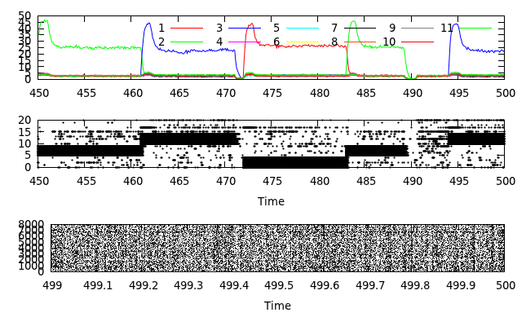
Overlap with patterns 1 … 3
Spike raster

Slide 59
Overlap with patterns 1 … 11 (80 patterns stored!)
overlaps
Spike raster

Slide 60
Memory with spiking neurons
Low activity of patterns?
Separation of excitation and inhibition?
Modeling?
Neural data?
All possible

Slide 61



6.4 memory data
Human Hippocampus
Sidney opera
Sidney opera
Sidney opera
Quiroga, R. Q., Reddy, L., Kreiman, G., Koch, C., and Fried, I. (2005).
Invariant visual representation by single neurons in the human brain.
Nature, 435:1102-1107.

Slide 62
6.4 memory data
Delayed Matching to Sample Task
Animal experiments
sample
1s
match
sample
1s
match

Slide 63
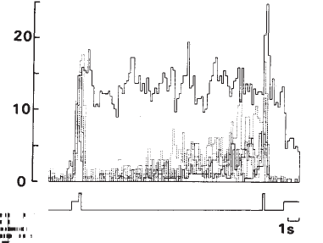
6.4 memory data
20
[Hz]
sample
1s
match
Miyashita, Y. (1988). Neuronal correlate of visual associative long-term memory in the primate temporal cortex. Nature, 335:817-820.

Slide 64
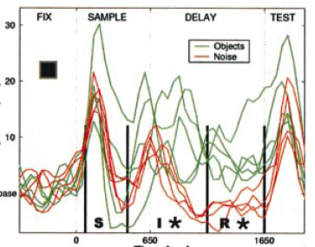
6.4 memory data
20
[Hz]
0
0
1650ms
sample
match
Rainer and Miller (2002). Timecourse of object-related neural activity in the primate
prefrontal cortex during a short-term memory task. Europ. J. Neurosci., 15:1244-1254.

Slide 65
Exercise 3 NOW- from Hopfield to spikes
In the Hopfield model, neurons are characterized by a binary variable Si = +/-1. For an interpretation in terms of spikes it is, however, more appealing to work with a binary variable xi which is zero or 1.
(i) Write Si = 2xi- 1 and rewrite the Hopfield model in terms of xi.
What are the conditions so that the input potential is
(ii) Repeat the same calculation for low-activity patterns and
and weights
with some constants a and b

Slide 66
The end

